Slide 1



UNIT 4:
So much to do, so little time
Call the number

Slide 2
How often do you use a phone?
Do you use a mobile phone or a landline?
What do you use it for?
Which apps do you use?
How often do you call someone? Who? Why?
How often do people call you? Who? Why?

Slide 3
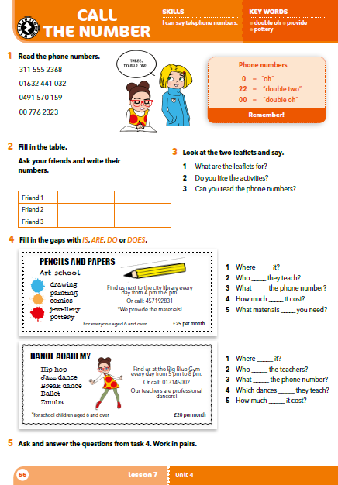
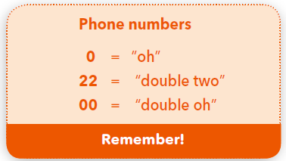
How do we read numbers in a phone number?

Slide 4
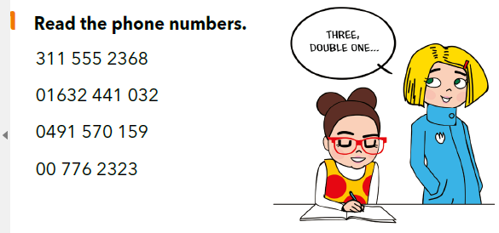
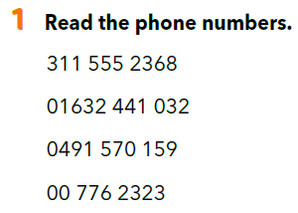
three, double one, double five, five, two, three, six, eight
oh, one, six, three, two, double four, one, oh, three, two
oh, four, nine, one, five, seven, oh, one, five, nine
double oh, double seven, six, two, three, two, three

Slide 5
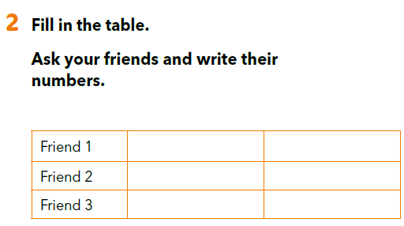
Example:
A: What’s your phone number?
B: My phone number is ___________.
or
It’s _____________.

Slide 6
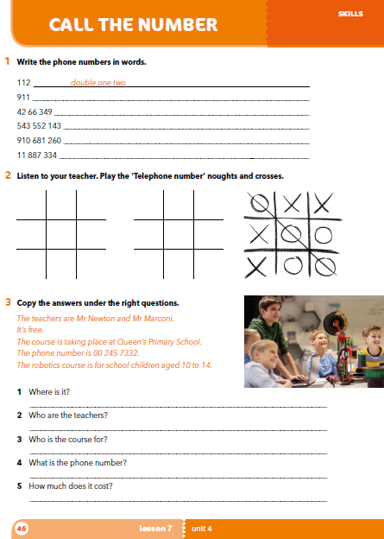
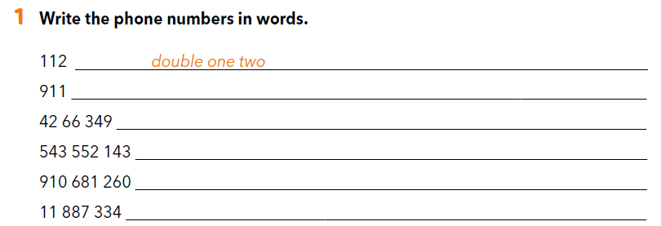
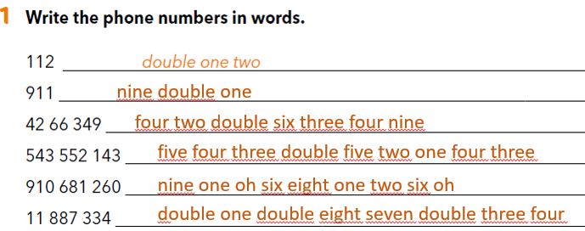
Workbook p 46.
Are there any other important numbers that you know?
Can you say them in English?
nine double one
four two double six three four nine
five four three double five two one four three
nine one oh six eight one two six oh
double one double eight seven double three four

Slide 7
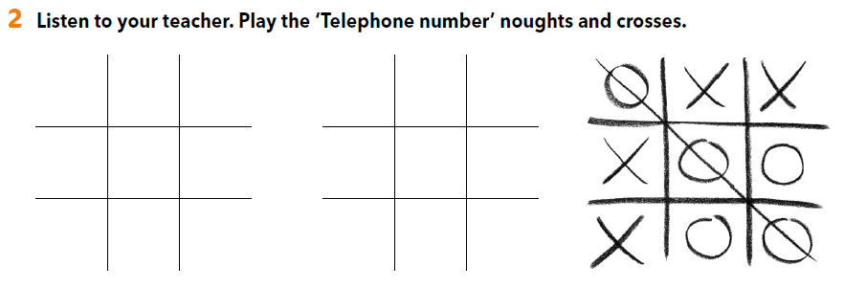
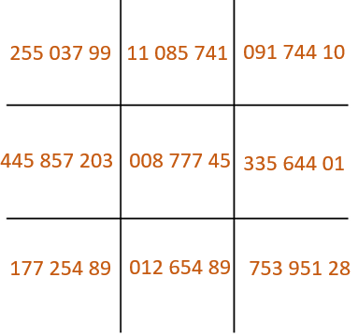
Polja ispuni telefonskim brojevima (poslušaj učitelja/icu koji će ti reći brojeve ili to učini samostalno). Odaberi polje u koje želiš upisati svoj znak (križić/kružić) i pročitaj telefonski broj. Ukoliko si točno pročitao broj,možeš upisati svoj znak.

Slide 8
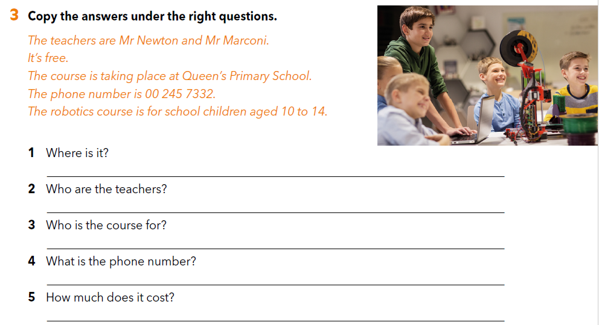
The course is taking place at Queen’s Primary School.
The teachers are Mr Newton and Mr Marconi.
The robotics course is for school children aged 10 to 14.
The phone number is 00 245 7332.
It’s free.

Slide 9
LET’S PRACTISE!
Play the game.
https://learningapps.org/watch?v=p29x1yync18

Slide 10
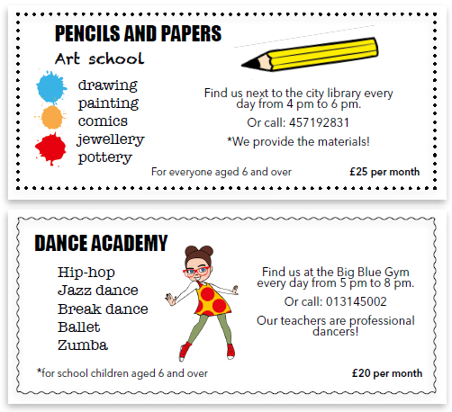
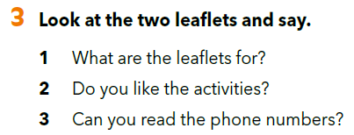
Who is on the second leaflet?

Slide 11
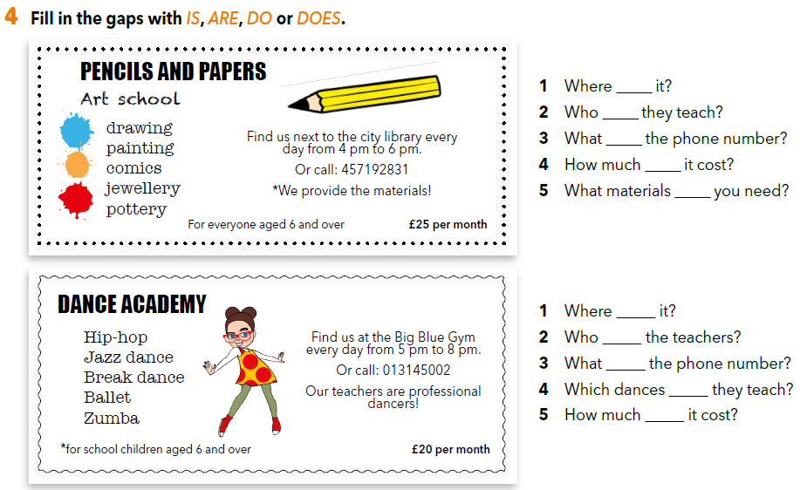
Answer the questions.
is
do
is
does
do
is
are
is
do
does

Slide 12
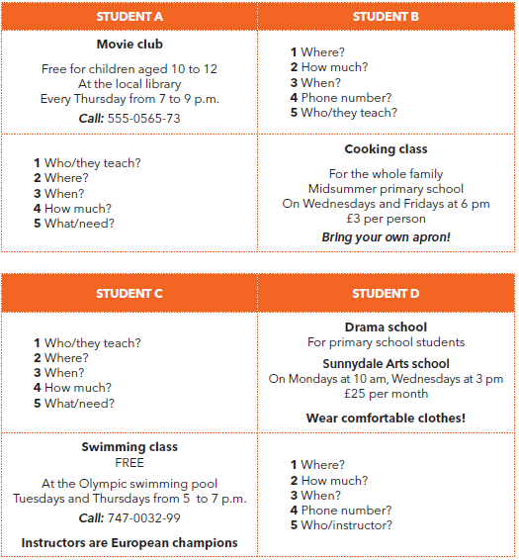
Choose a card (student A, B, C or D).
Your friend will choose a different card.
Use the cues and ask your friend a question about his/her activity.
Your friend asks you questions about your activity and you answer them by using the information from your card.

Slide 13

SELF CHECK
https://www.e-sfera.hr/dodatni-digitalni-sadrzaji/74d7d1f8-f9cd-4a49-9ec3-2177a225f6fa/

Slide 14
LEARN MORE.
https://www.e-sfera.hr/dodatni-digitalni-sadrzaji/74d7d1f8-f9cd-4a49-9ec3-2177a225f6fa/
What is there… of?

